Slide 1
Greenhouse Water & Fertilizer Recycling
Presented by Eric Labbate
CEO of the Climate Control Systems Inc.

Slide 2
Irrigation Water problems ?
Source water can be high in Iron, Manganese,
or Sulfur or other undesirable elements.
Water can be colored with undesirable odor and unwanted solids.
Water could be contaminated with Bacteria, Viruses and/or Algae
Water may have a high pH causing scaling and plugging of irrigation emitters.
Water could have high EC with too many undesirable elements.

Slide 3
Solve Irrigation water problem?
Filter the water with a Filox or MicroZ media filters with automatic back wash cycle. Filters down to 5 microns
Treat the water with Ozone to destroy color and odor
Treat water with Ozone to destroy Bacteria, Pathogens
and Algae
If pH is too high treat the water with Nitric Acid or Phosphoric Acid to bring pH down to desired levels.
If EC is too high use RO system to remove 99 % of the unwanted elements.

Slide 4
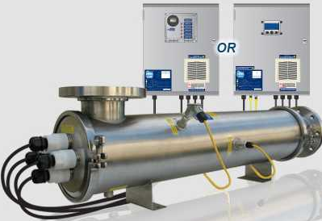
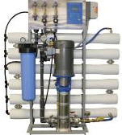
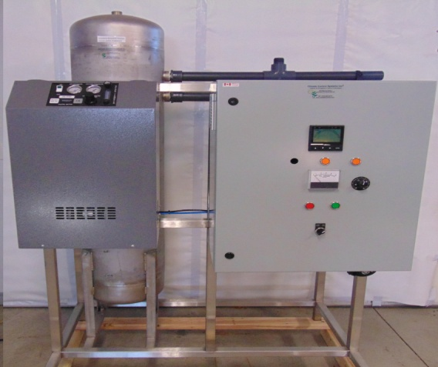
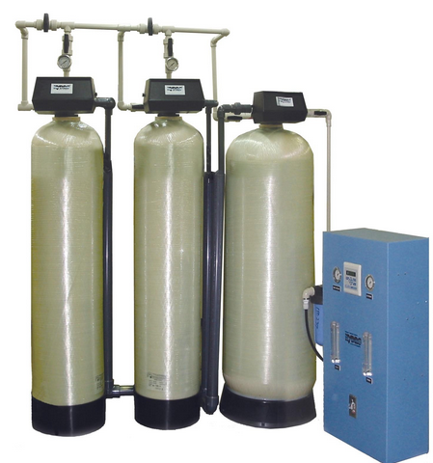
Existing Water Treatment Systems
Reverse Osmosis
UV
Ozone Treatment
Filter system

Slide 5
Ozone Vs UV Treatment
Problem | UV | Ozone
Bacteria Pathogens and Algae | Stunts Bacteria | Kills Bacteria
Clears up Color and Smell of Water | NO | Kills Color & Smell
Effective in Dirty water | No | Yes
Water Oxidization | NO | Yes
Removes Biofilm | No | Yes

Slide 6
Ozone water sterilization
Proven technology for water sterilization
The reactive nature of ozone makes it the ideal oxidant for water treatment without use of chemicals
Destroys bacteria, viruses, algae and odor
Precipitate heavy metals (Iron & Manganese) allowing them to be filtered
Oxidizes organic compounds that can be easily flocculated and filtered
Ozone as an Oxidant sterilizes the water, kills all living organism, and return to oxygen in a short period of time.

Slide 7
Benefits for Water & Fertilizer Recycling
Recapture irrigation waste water, retreat and reuse.
The Oxygen content is very beneficial to the roots enhancing plant growth.
Saves the grower 35% to 40% on Water and Fertilizer usage with “0” run off.
Meets environmental regulations

Slide 8
Typical water treatment System for Hydroponic Crops
filtration
RO
system
Water Supply Pump
StorageTank
Fertigation
Control
Level
meter
Water pump
Water sterilization
EC
meter
filtration
Water pump
Water collection tank

Slide 9
Ozone Water Treatment System CA450 Max flow 350 GPM (Algeria Project)

Slide 10
Ozone Water Treatment System CA450 Water cooled Ozone Reactor (Algeria Project)

Slide 11
Ozone Water Sterilization System CA80 Leamington Tomato Project

Slide 12
Ozone Water Treatment System CA40 DFT Lettuce Project – Mirabel Project

Slide 13
Ozone Water Treatment System CA20 Mexico Project

Slide 14
Fertigation Manager™
Patented technology for Fertilizer management

Slide 15
Fertigation Manager ™ P1
The word Fertigation is combined word of Fertilization and Irrigation in one word “Fertigation”. It was first used in the early 80s in our research reports on the Fertigation Manager ™ for greenhouse vegetable crops.
Fertigation Manager ™ is a fertilizer and irrigation management system to blend fertilizer recipes for EBB & Flow, DFT, NFT, or any hydroponic and drip irrigated crop.
The Fertigation Manager ™ offers prescheduled Fertigation programs and can control water pump and irrigation valves.
Can be started by 5 day/night time programs, start with accumulated solar levels, external VPD sensor or substrate moisture sensors.

Slide 16
Fertigation Manager ™ P2
Fertigation Manager™ ideally suited for Cannabis Grower
It measures and controls, water flow, EC and pH
Precisely inject fertilizers in milliliters directly into water line
Controls up to12 fertilizer injectors (expandable to 16)
Control up to 48 irrigation valves (expandable to 96)
Soil/Substrate moisture sensors can average 2 sensors per irrigation zone
Maximum 24 moisture sensors per system

Slide 17
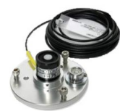
Fertigation Management Main Screen
10 Fertilizer Recipes
EC
Solar sensor
12 fertilizers solution
Water flow
sensor
PH sensor

Slide 18
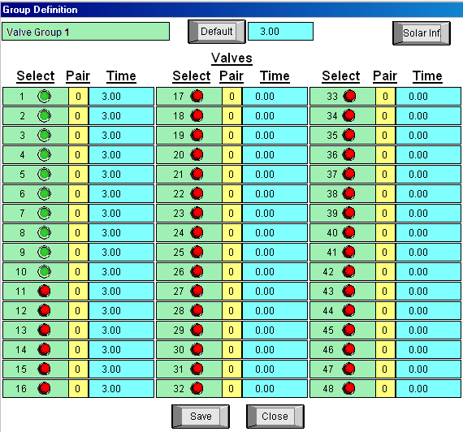
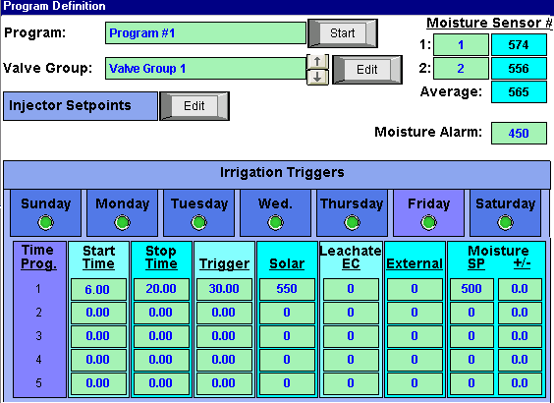
Fertigation Manager ™ Injector Setup Screen
Injector Setup
Irrigation Valve
Setup
Moisture Set points
Time, Solar Set points

Slide 19
Fertigation Manager SK400 (Leamington Marijuana project)

Slide 20
Fertigation Manager SK800 (Nevada Marijuana Project)

Slide 21
Fertigation Manager PRO700 (Vineland Research Center)

Slide 22
Fertigation Manager AN600 (Florece - Puerto Rico)

Slide 23
Introducing
Climate Manager ™

Slide 24
Climate Manager ™
Climate Manager ™ is a environmental climate and irrigation control computer system for the commercial Cannabis growers.
Control up to 16 growing compartments.
System is designed to control temperature, humidity, Co2 and Odor control.
Controls pad & fans, dampers, louvers, vents thermal and solar shading, HID & Led lighting, Controls hot water and steam heating systems, air heaters, fog, misting, Co2 and much more.

Slide 25
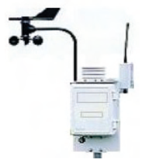
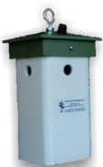
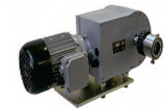
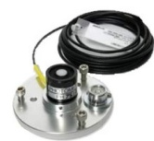
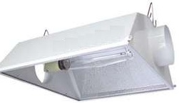
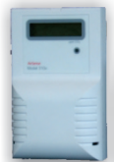
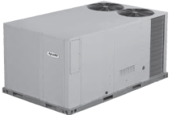
Climate Manager Main Screen (Sensing and control)
Temp& Humidity
Sensor
Vent control
Solar sensor
Weather station
HID lights
Hot Water
CO2 sensor
Heating
Cooling

Slide 26
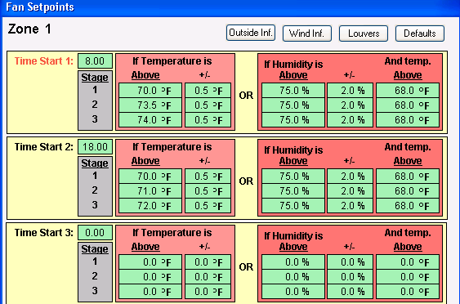
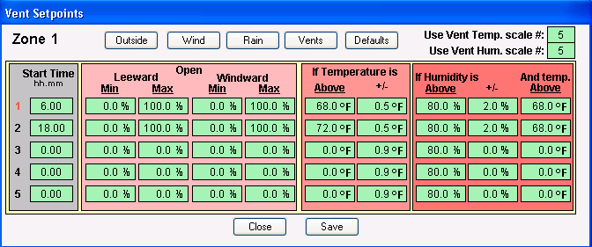
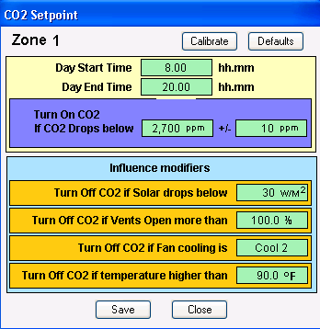
Climate Manager Programs
16 Lighting
Programs
16 Cooling
Programs
16 Vent Programs
16 Co2 Program

Slide 27
Climate Control Systems Inc.
Climate Control Systems is known internationally for greenhouse automation technology for the last 30 years (since 1985)
Our products are the Climate Manager™, Fertigation Manager™ and Ozone Water Treatment systems.
These products help hydroponic growers to maximize crop yields, manage energy costs, and provide water and fertilizer conservation.
On June 30,2015 Climate Control Systems Inc. is celebrating its 30th anniversary.

Slide 28
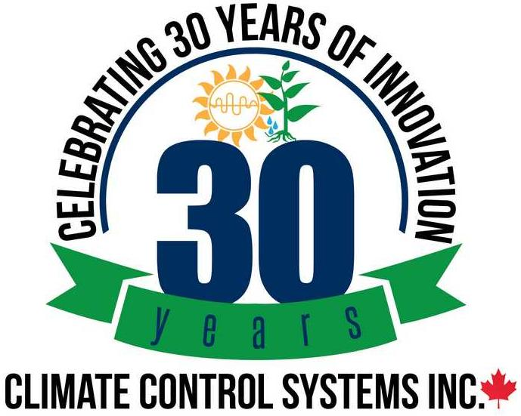
Thank you
Contact: eric@climatecontrol.com
Website: www.climatecontrol.com
Tel: +1 519-322-2515

